Slide 1
Outlier Detection in Stream Data by Clustering
Dr. Abbas Najafizadeh
Heydar Mahmoodi
Data mining

Slide 2
برای کشف داده‌های پرت در جریان داده، یکی از روش‌های مورد استفاده خوشه‌بندی است. خوشه‌بندی به ما کمک می‌کند تا داده‌ها را به گروه‌های مشابه تقسیم کنیم و داده‌های پرت را از خوشه‌های عادی تشخیص دهیم. یکی از الگوریتم‌های خوشه‌بندی معروف برای کشف داده‌های پرت، الگوریتم DBSCAN است.
DBSCAN (Density-Based Spatial Clustering of Applications with Noise) یک الگوریتم خوشه‌بندی است که بر اساس چگالی داده‌ها عمل می‌کند. این الگوریتم به ما امکان می‌دهد خوشه‌هایی را که دارای چگالی بالا هستند تشخیص دهیم و داده‌های پرت را از خوشه‌های کم چگال جدا کنیم. با استفاده از DBSCAN، می‌توانیم داده‌های پرت را در جریان داده شناسایی کنیم.
در این روش، ابتدا باید پارامترهایی مانند شعاع همسایگی و تعداد حداقل داده‌ها برای تشکیل یک خوشه را تعیین کنیم. سپس الگوریتم DBSCAN را روی داده‌ها اجرا می‌کنیم تا خوشه‌ها و داده‌های پرت را شناسایی کنیم.
استفاده از خوشه‌بندی برای کشف داده‌های پرت در جریان داده می‌تواند در بسیاری از حوزه‌ها مفید باشد، از جمله تحلیل داده‌های حجیم، تشخیص تقلب در تراکنش‌های مالی، تحلیل رفتار کاربران در شبکه‌های اجتماعی و غیره.
منابع:
' ...'
'A Conceptual Framework for Preprocessing and Improving Quality ...'

Slide 3
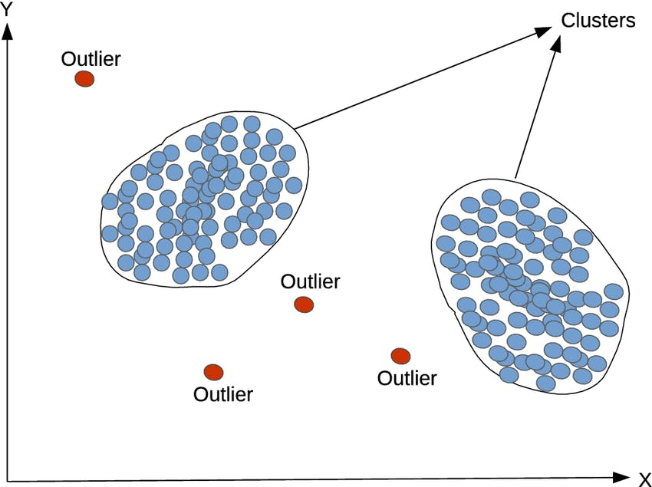
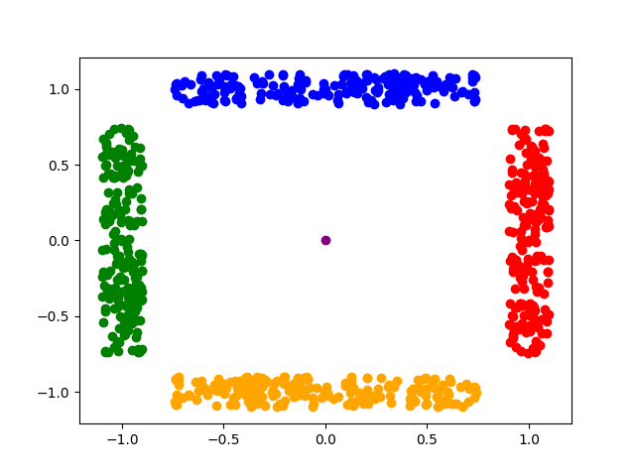
Introduce
Exploring real-time anomaly detection through clustering methods in streaming data.

Slide 4
Where?
weather forecast information
monitoring information for network media transmission
sensor transfer information in coal mines
access to website information
economic information produced by finance and securities companies
Fraudulent Financial Transactions Detection
agricultural, engineering control and so on

Slide 5
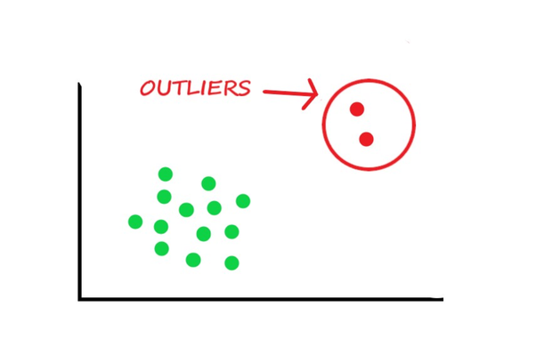
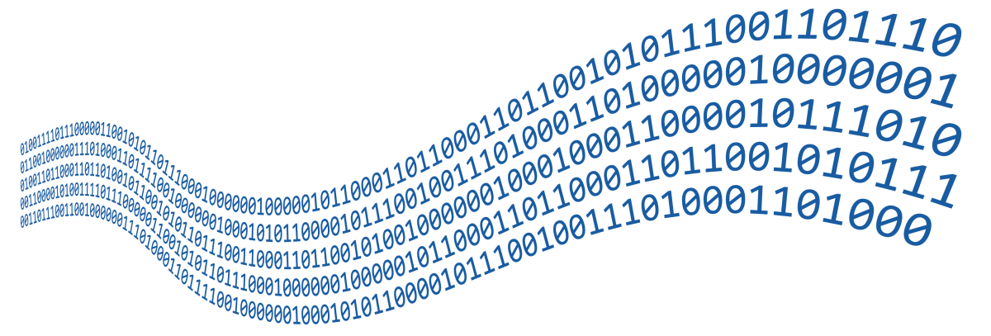
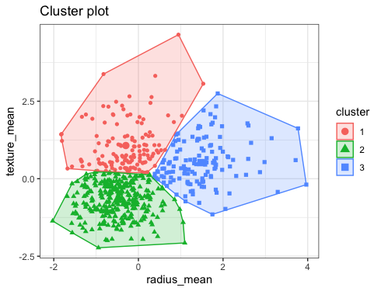
Case study
Outlier Detection
Stream Data
Clustering

Slide 6
Why?
In view of the characteristic of the high dimension, dynamic, real-time, many effective data stream clustering algorithms have been proposed
In addition, data stream information are not deterministic and always exist outliers and contain noises, so developing effective data stream clustering algorithm is crucial
Because of this form of data is massive and updated in real time, traditional clustering methods cannot be used to process it.

Slide 7
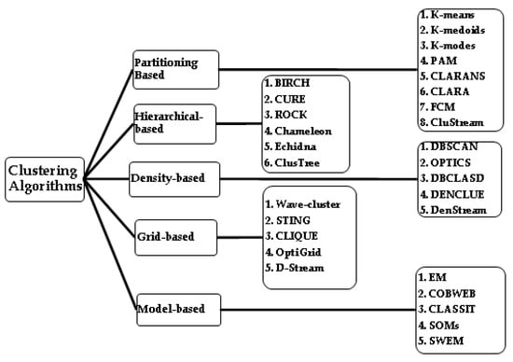
Overall

Slide 8
MATLAB Categories
Hierarchical Clustering
k-Means and k-Medoids Clustering
Density-Based Spatial Clustering of Applications with Noise (DBSCAN)
Gaussian Mixture Model
k-Nearest Neighbor Search and Radius Search
Spectral Clustering

Slide 9
Which method?
Data Characteristics: Density-based methods like DBSCAN suit datasets with varying cluster densities.
Cluster Shape: For non-spherical clusters, density-based or hierarchical methods might be better.
Scalability: Partitioning methods like K-Means are more scalable for larger datasets.
Interpretability: Hierarchical clustering provides an insightful dendrogram.

Slide 10
DataStream vs TraditionalData
Compared with traditional data forms, data stream has its own characteristics.
Traditional data
static and stable
accessed at any time
processed more than once
Data stream
dynamic and it flows like a stream (sequential and changes over time)
Real-time , continuous , ordered (large amount of data , potentially unlimited , arrival rate uncertain)

Slide 11
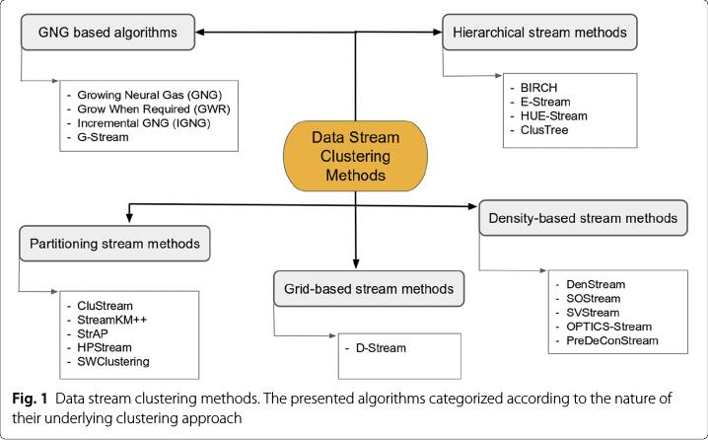
https://cs.stackexchange.com/questions/79429/what-is-the-best-stream-data-clustering-algorithm-that-can-handle-non-static-un

Slide 12
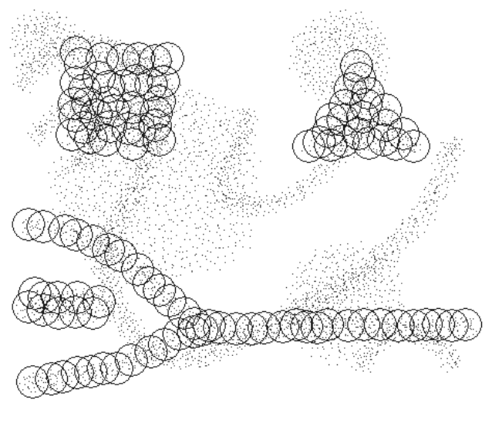
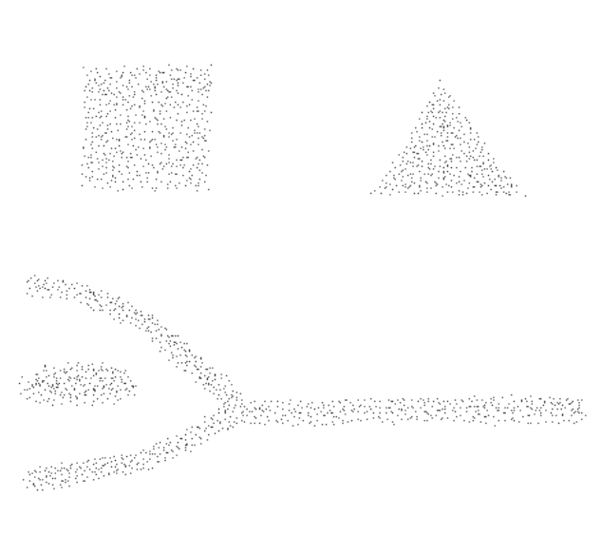
DenStream
Density-Based Clustering over an Evolving Data Stream with Noise
10.1137/1.9781611972764.29 , researchgate link

Slide 13
DBSCAN
Pros:
Robust to outliers: Can identify outliers as noise points.
Handles arbitrary-shaped clusters: Not limited to spherical clusters.
No need K: It does not require the number of clusters to be specified in advance.
Cons:
Parameter-sensitive: Requires setting parameters like epsilon and minPoints, which can impact results.
Difficulty with varying densities: Struggles when clusters have significantly different densities.
high computational cost: It has a high computational cost when the number of data points is large.

Slide 14
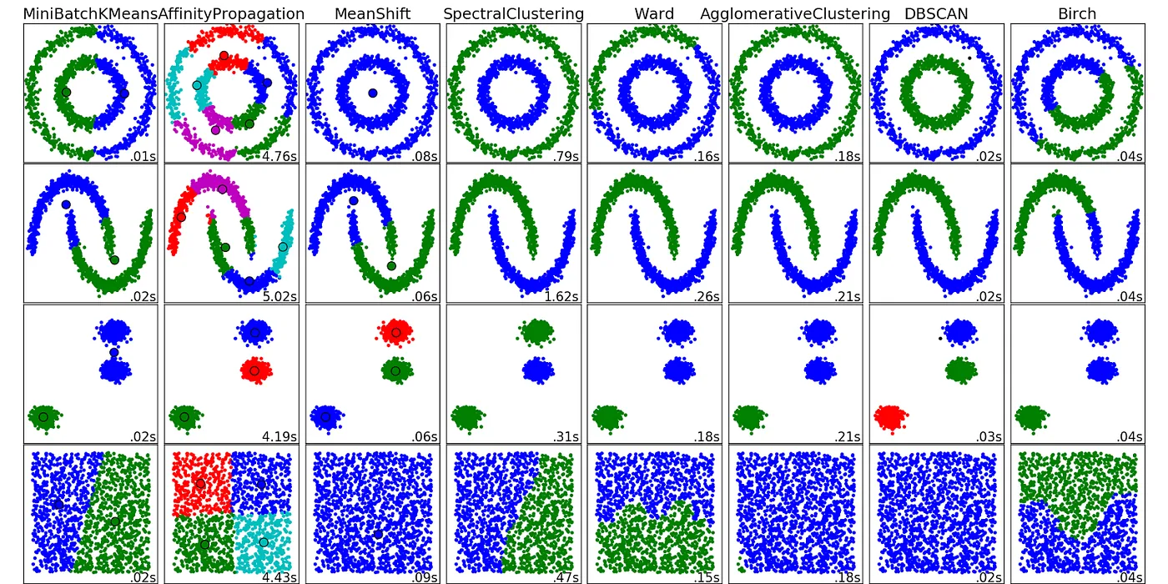
DBSCAN vs …

Slide 15
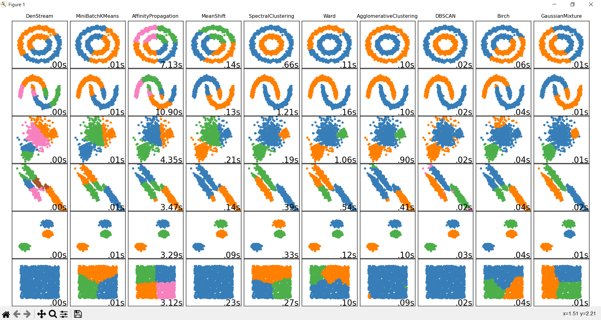
Comparing DenStream(https://github.com/SC-One/DenStream)

Slide 16
LAST PAGES
TODO: summarize the latest research achievements in this field and introduce some new strategies to deal with outliers and noise data

Slide 17
Future
focal points and difficulties of future research for data stream clustering:

Slide 18
Refrences
https://www.sciencedirect.com/science/article/abs/pii/S0167739X19312786
https://www.researchgate.net/figure/Overview-of-the-proposed-two-step-clustering-method-The-first-step-uses-Birch-clustering_fig4_357972949https://www.oreilly.com/library/view/data-mining-and/9781118868706/9781118868706c21.xhtml
https://scikit-learn.org/stable/modules/generated/sklearn.cluster.Birch.html
https://www.geeksforgeeks.org/ml-birch-clustering/
https://en.wikipedia.org/wiki/Data_stream_clustering
https://medium.com/@noel.cs21/balanced-iterative-reducing-and-clustering-using-heirachies-birch-5680adffaa58https://www.youtube.com/watch?v=YWcDgX_pN-8
https://www.youtube.com/watch?v=A4MzbYc4yCY
https://www.sciencedirect.com/science/article/abs/pii/S0167739X19312786
https://doi.org/10.1016/j.future.2020.01.017
https://www.logsign.com/blog/data-stream-clustering-methods-examples
https://arxiv.org/abs/2210.08212
https://github.com/dple/awesome-papers-and-source-code-for-anomaly-detection
https://www.iwrr.ir/article_87950.html
https://www.sid.ir/paper/159026/fa
https://smartinsight.ir/%D8%B1%D9%88%D8%B4-%D9%87%D8%A7%DB%8C-%D8%AF%D8%A7%D8%AF%D9%87-%DA%A9%D8%A7%D9%88%DB%8C/
https://science.ut.ac.ir/documents/84413665/110319729/kord-asabi.pdf
https://www.geeksforgeeks.org/clustering-in-data-mining
https://www.geeksforgeeks.org/data-mining-cluster-analysis/
https://blogs.sap.com/2020/12/16/outlier-detection-by-clustering/

Slide 19
Refrences(cont...)
https://dl.acm.org/doi/10.1145/1557019.1557041
https://dl.acm.org/action/downloadSupplement?doi=10.1145%2F1557019.1557041&file=p139-bifet_nemeds_01.mp4
https://python.plainenglish.io/how-does-the-dbscan-algorithm-work-pros-and-cons-of-dbscan-bbdd589d837a
https://dzone.com/articles/data-streaming-in-osgi-r7-applications-with-osgi-r

